Slide 1
Test For Web Full Stack Developer
You will Be rewarded with Extra Marks for code optimization if performed
Note: Make a separate file for your Test and Submit it to the assigned examiner.

Slide 2

Question: 1.
Create bootstrap responsive div like the picture given below.
Zoom in image on hover.
When hover is zoomed in the color should get transparent.

Slide 3
Test For jQuery

Slide 4
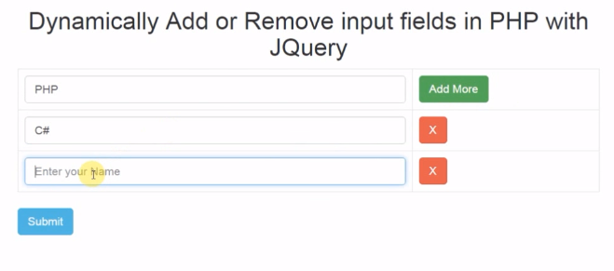
Question: 1
After submission of the Form print the result of all fields.

Slide 5
Test For SQL Databases

Slide 6
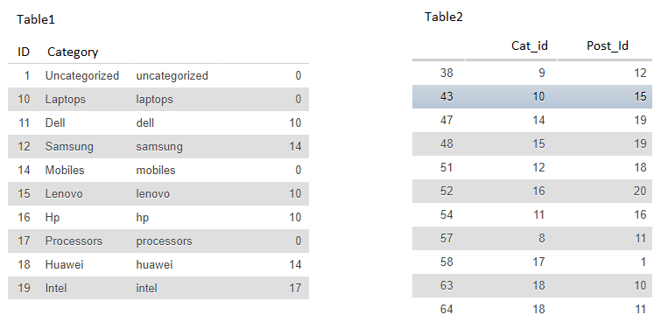
Question:1.
Write SQL Query, get the categories names having Post IDs 19

Slide 7
Question: 2
Write the table and column names for the students and their classes entities (Many-to-many relationships).

Slide 8
Test For PHP

Slide 9
Question: 1
Write a program in PHP to compute
“ Whether the user provided number is a prime number or not. If the number is prime apply a mysqli query to insert the number in database”

Slide 10
Test For Ajax + PHP

Slide 11
On clicking the input type file the image should be get displayed on form and it should also be upload into folder at the same time. On submitting form the file (image) name insert it into either database or simply print.

Slide 12
Any Questions ?
Please ask the Examiner if you have any questions related to the test.
Thank you

